Slide 1
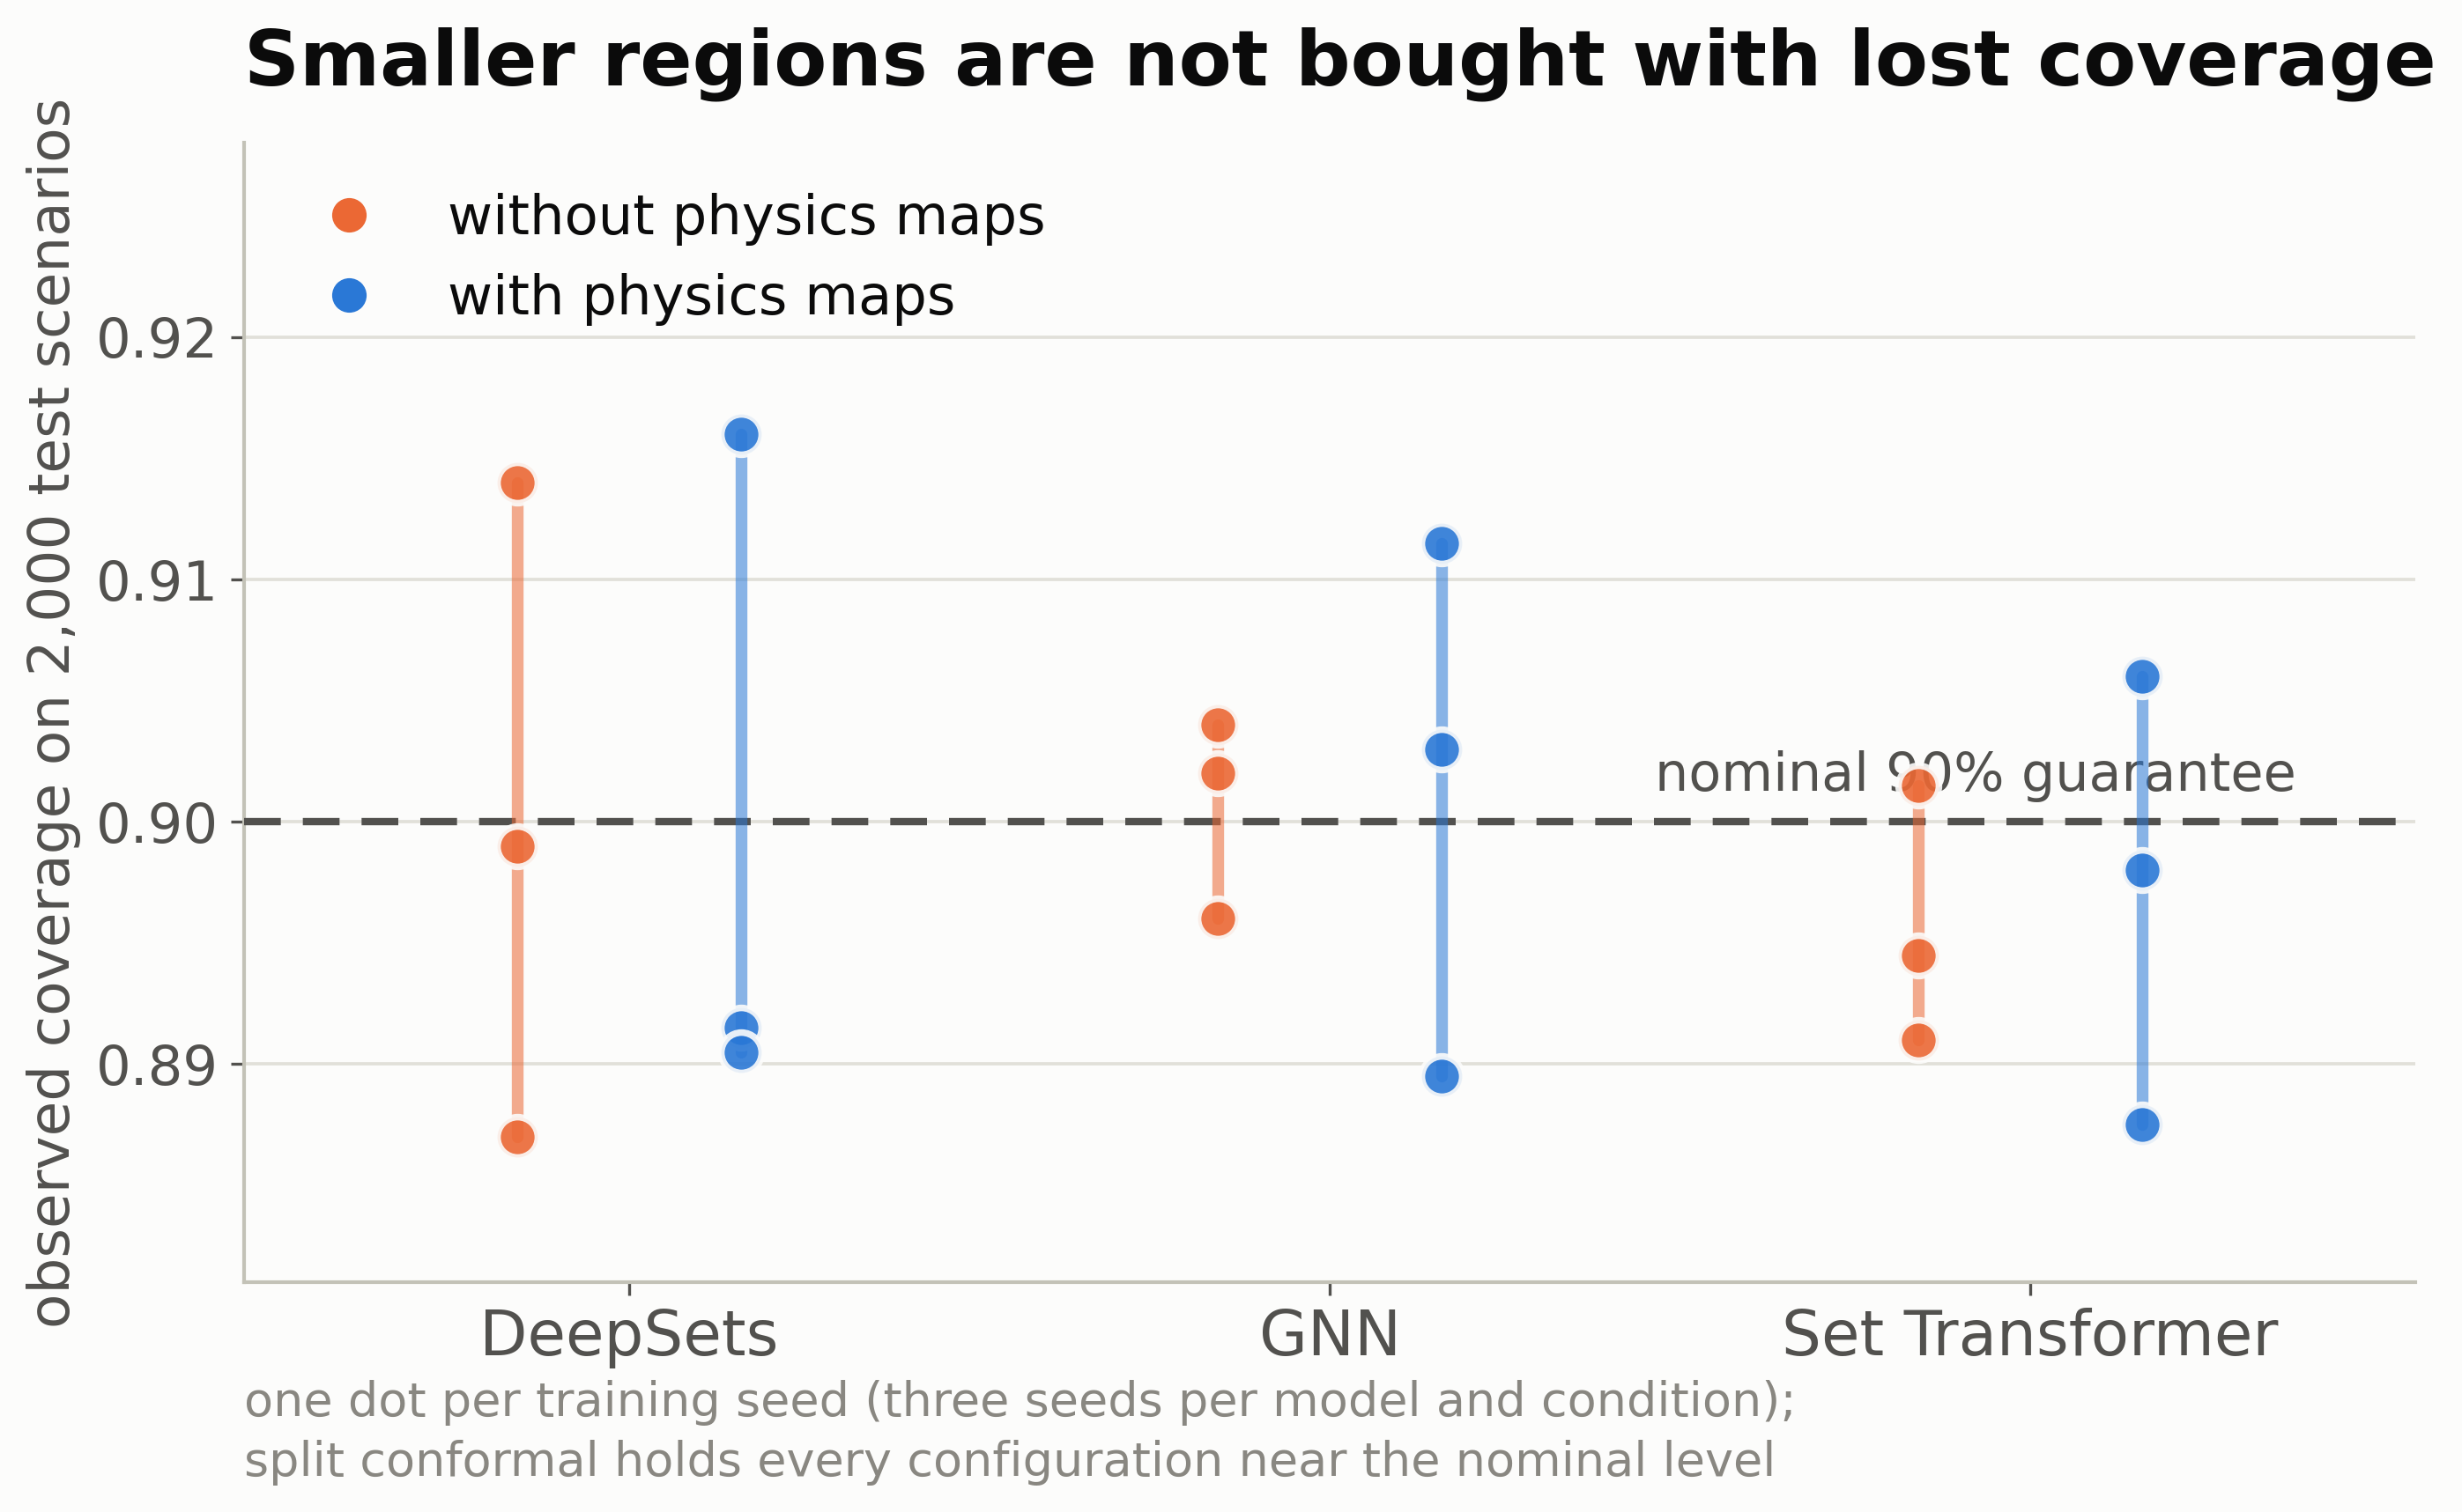
The smaller regions are not bought with lost reliability: observed coverage stays at the nominal 90% guarantee for every model, training seed, and condition.

